Slide 1



PnP Transformation Preparedness meeting – Development and ALM
<Consultant Name>
<Company Name>
Notes:
ALM – Application Lifecycle Management

Slide 2
Positioning in the PnP Transformation approach

Slide 3
Application Modernization PnP Transformation Approach
Customer Preparedness
Solution Assessment
Architecture Session
STEP 1
Empower & Plan
App hosting configuration. Leverage available resources to ramp up Dev resources
Analyze solution inventory / requirements and provide guidance on solution modernization
Provide architecture design guidance for selected scenarios
Deliverable:
Successful smoke test app to validate configuration
Deliverable:
Assessment report
Deliverable:
Architecture Design Report
Development SOW (optional)
Development & Testing
Deployment
STEP 2
Develop & Deploy
Jointly work on development and testing with MS partners
Retract FTC
Deploy App solutions
Deliverable:
Tested solution artifacts
Deployment Guide
Deliverable:
Replace FTC by APP
Project signoff
Notes:
FTC: Full Trust Code
SOW: Statement of Work

Slide 4
Empower & Plan
Customer Preparedness
3 days of consultation to prepare app hosting options. Leverage available resources to ramp up development resources. Result is a successful end-to-end smoke test app to validate configuration on both sides.
Engagement Criteria | Roles & Responsibilities |  | Deliverable
 | Customer | Microsoft Partner
Post SP 2013 DB upgrade Farm max compatibility is 15 Decision on app hosting choice Procure hosting infrastructure | Internal resource readiness for App training Set up hosting infrastructure Complete configuration | Consulting Infrastructure planning Security App governance & ALM Building future proof modern apps Support Troubleshooting configuration | Complete infrastructure set up (Azure or on-premises) Successful configuration validation
Troubleshooting Day 2-3
Module Overview
Everybody
Hosting environment ready
Deploy verification app to hosting environment
Configuration – Day 1
Configure communications across SPO and hosting farm
Network configuration
Service configuration (proxy)
Next steps
IT Admin
Requirements
Stage
Everybody
Audience
Notes:
SPO – SharePoint Online
ALM – Application Lifecycle Management

Slide 5
Development

Slide 6


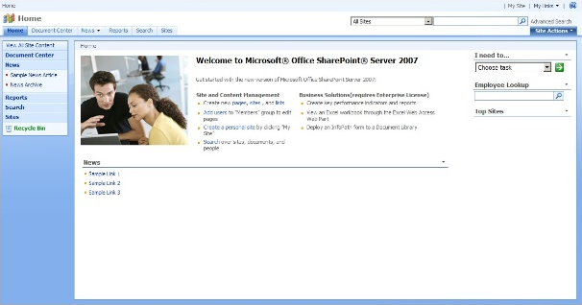
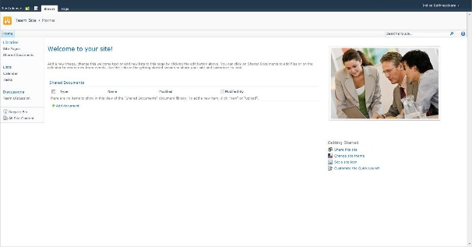
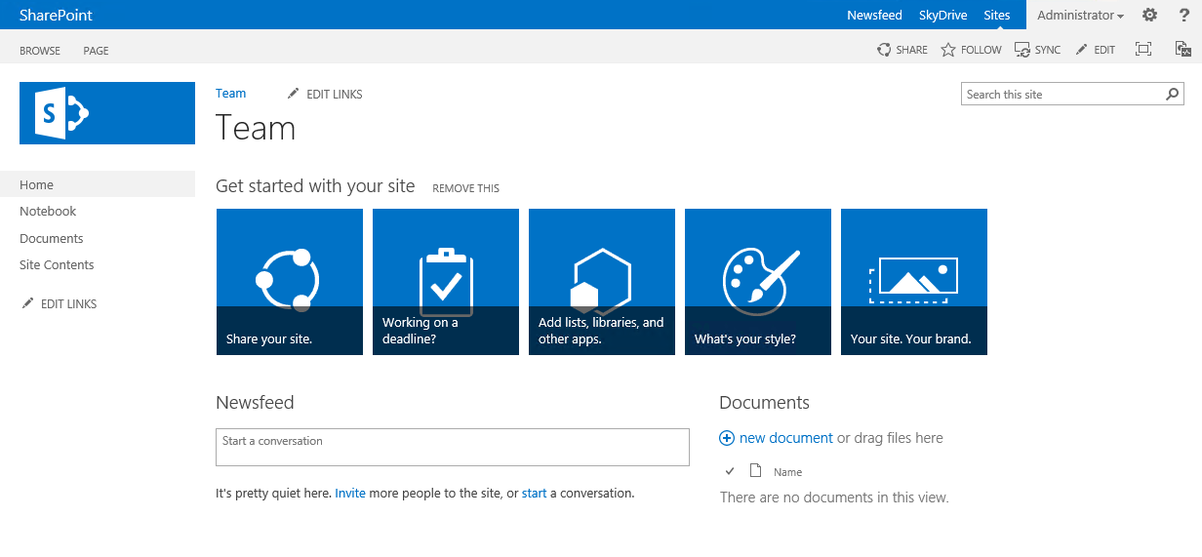
SharePoint evolves…
Provider Hosted Apps
C#
SharePoint 2007
SharePoint 2010
C#
SharePoint 2013
C#
Sandbox
_api
C#
JS
JS

Slide 7
Impact of the customizations
Maintenance and operational costs, including availability challenges
Agility to deploy new functionalities and widgets
Long term roadmap impact
Notes:
Title: Impact of the Customizations
Time: 1 minute

Slide 8
Benefits of App Model
No custom code on the SharePoint server
Easier to upgrade to future versions of SharePoint
Works in hosted environments w/o limitations
Reduces the ramp-up time for those building apps
Don’t need to know/be as familiar with SharePoint “-isms”
Apps can leverage hosting platform features
Enables taking SharePoint apps to different levels – further than what can be done with farm / sandbox solutions
Functionalities can be moved to and from the cloud to any SharePoint deployment

Slide 9

SP App Hosting Options
SharePoint
Oauth + REST or client object models
Existing sites and services
The app and all resources are hosted by the provider in any environment suitable for the app.
App web (optional)
Removed
Auto- hosted
Oauth + REST or client object models
Existing sites and services
The app is hosted in the cloud. Windows Azure and SQL Server Azure components are provisioned automatically when an app is installed. (Available for SharePoint Online only)
App web (optional)
Windows Azure & SQL Azure
SharePoint
hosted
Existing sites and services
The app and all resources are hosted in your organization’s SharePoint farm. Relies on client side technologies. Your IT organization supports the app.
App web
Notes:
Apps for SharePoint can be self-hosted by a developer, auto-provisioned by Azure, hosted by SharePoint, or a combination of these. All can leverage SharePoint components. Custom code can only be run in developer self-hosted or Azure auto-provisioned hosting options.
The app is hosted in the cloud. Windows Azure and SQL Server Azure components are provisioned automatically when an app is installed. (Available for SharePoint Online Service only.)

Slide 10
App Shapes for SharePoint
Full page
Implement complete app experiences to satisfy business scenarios
Parts
Create app parts that can interact with the SharePoint experience
UI Command extensions
Add new commands to the ribbon and item menus

Slide 11
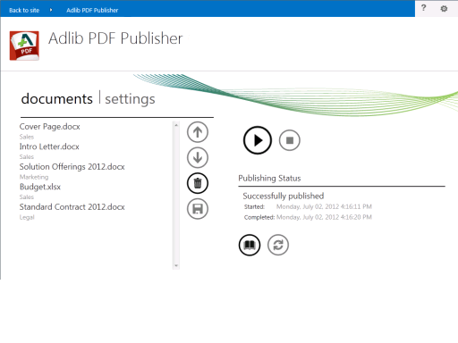
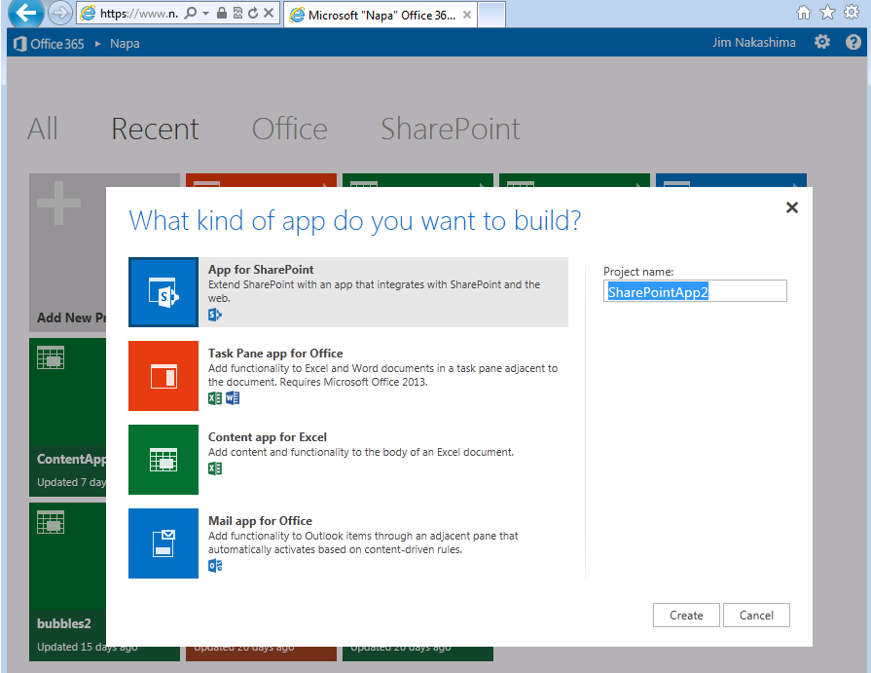

Slide 12
App Shapes for SharePoint
Full page
Implement complete app experiences to satisfy business scenarios
Parts
Create app parts that can interact with the SharePoint experience
UI Command extensions
Add new commands to the ribbon and item menus

Slide 13
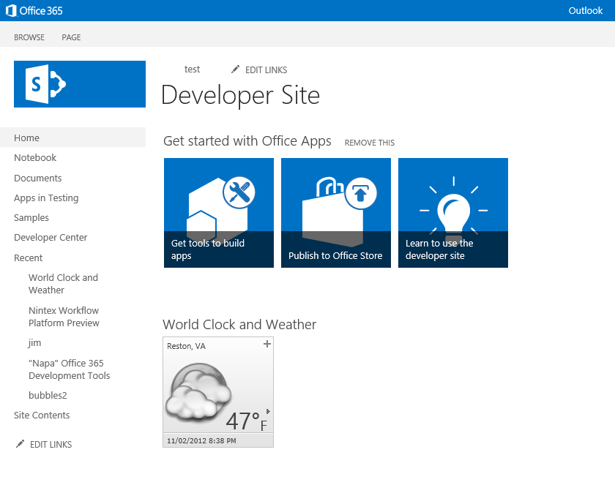
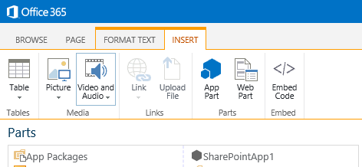

Slide 14
App Shapes for SharePoint
Full page
Implement complete app experiences to satisfy business scenarios
Parts
Create app parts that can interact with the SharePoint experience
UI Command extensions
Add new commands to the ribbon and item menus

Slide 15
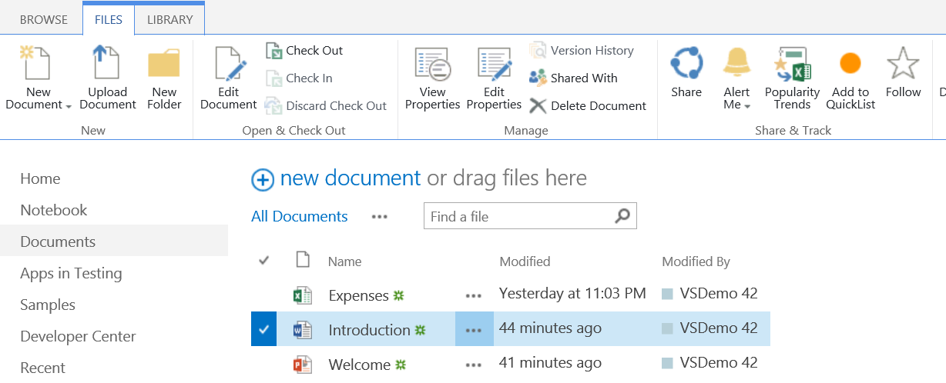
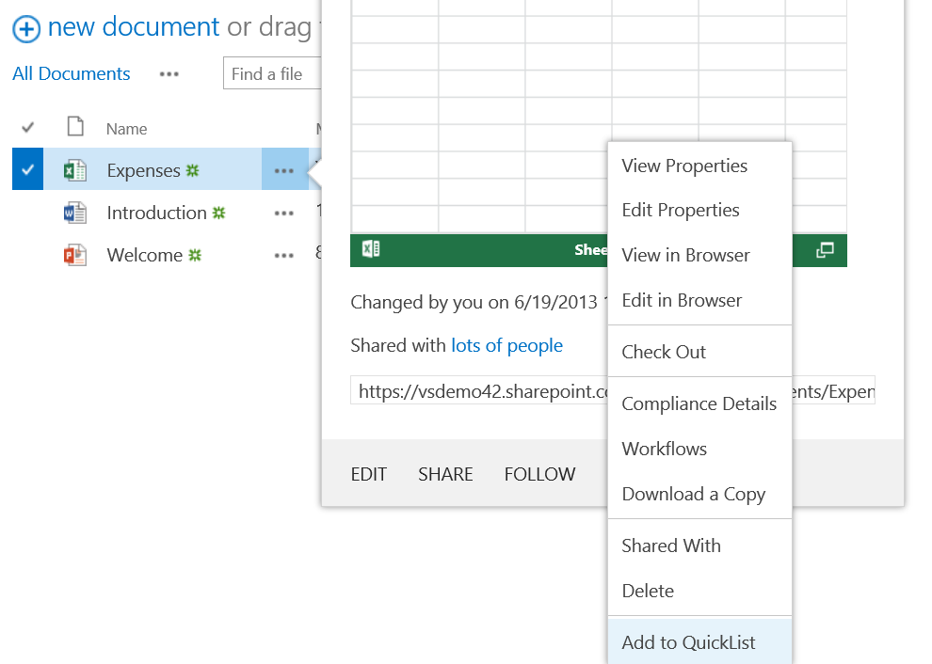
UI Command – Ribbon/Menu Action

Slide 16
App authentication with SharePoint
Two options in SharePoint
ACS based – so called two legged oAuth model where trust is established using third party provider, which in this case is the ACS
Server to server or high trust – trust is established directly between the app and the SharePoint farm using certificate
App authentication does not affect implementation details
ACS model is required with Office 365 and does require provider hosted environment to have Internet connectivity
Notes:
ACS – Access Control Service
More information on MSDN (https://msdn.microsoft.com/en-us/library/office/fp142384.aspx)

Slide 17
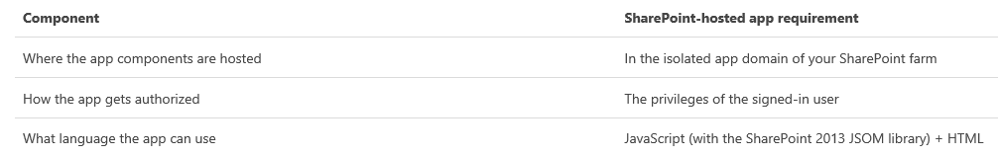
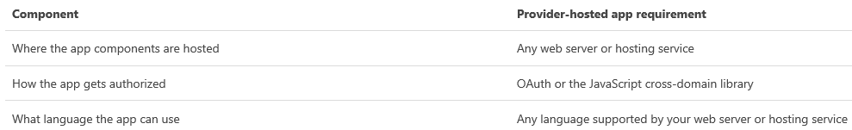
Provider hosted vs SharePoint hosted
SharePoint hosted:
Provider hosted:
Notes:
More information on MSDN (http://msdn.microsoft.com/en-us/library/office/fp179887(v=office.15).aspx )

Slide 18
Required developer skills for app model
Understanding of SharePoint client side object model and REST interface
Use of standard client side techniques for JavaScript based implementations, including jQuery and other common libraries for standard web development
Standard ASP.NET web development experience
Ability to promote out of the box capability reuse
Use OOB, rather than adding each widget as custom solution
Business case analysis of complex requirements. Cost vs. value analysis
Notes:
OOB – Out of Box

Slide 19


Transform your code Providing App Model Patterns for common Full Trust Code scenarios
100+ Visual Studio projects Common scenarios
Branding
Site provisioning
Remote event receivers
Large file support
Taxonomy driven navigation
And much more…
Contribute
This is open source project and open for contributions
Developer
Patterns & Practices
aka.ms/OfficeDevPnP

Slide 20
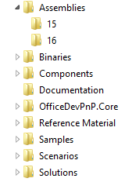
PnP Structure – folders and code
All referenced assemblies are included in package.
Contains latest 15 & 16 versions of the CSOM components.
No need for additional downloads
Reusable components targeted for reuse as such in projects.
Various Presentations on different scenarios.
Reusable remote operation component with extensions methods to standard CSOM objects.
Sample projects. Independent samples demonstrating a capability or functionality.
Scenario demonstrations for the usage of the core component. Contains additional explanations and usage models for API patterns.
Complex reusable solutions demonstrating combining multiple capabilities for building real solution. Uses core component.

Slide 21
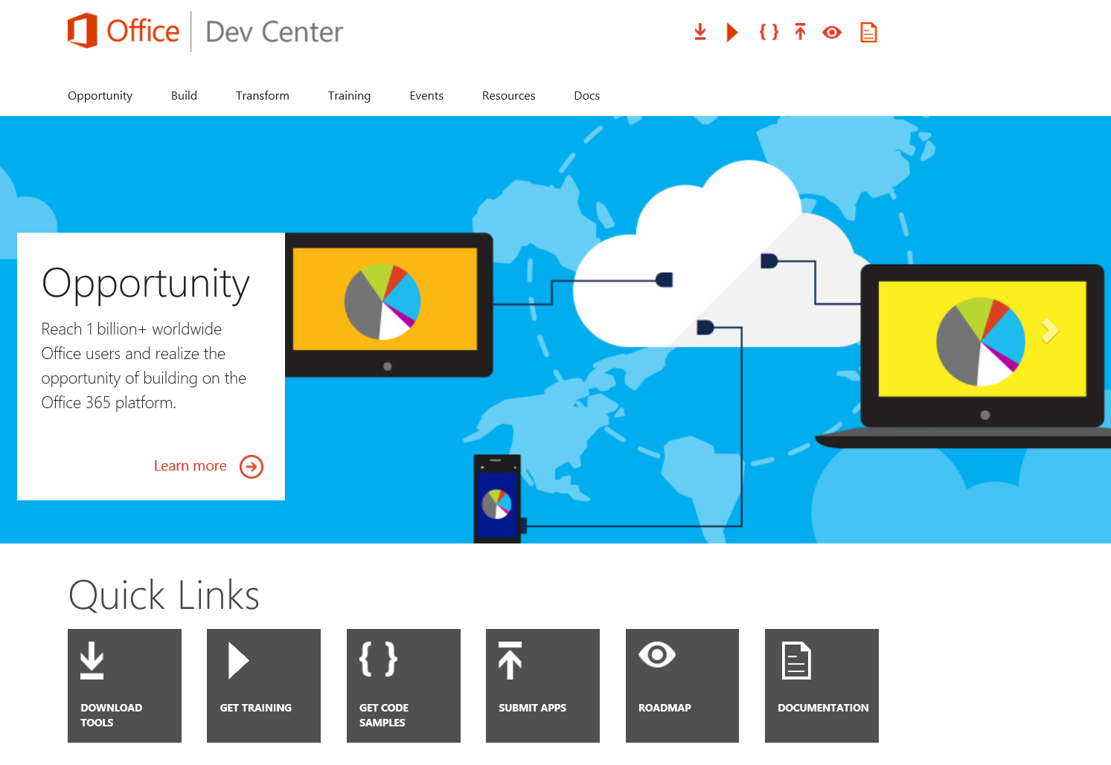
http://dev.office.com

Slide 22

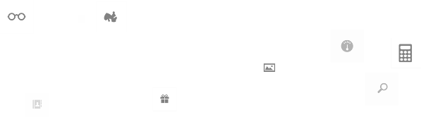
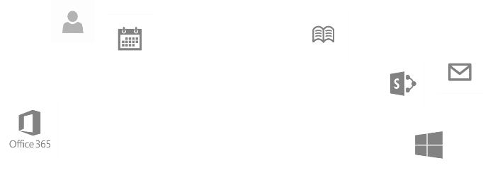
Calls to action
Explore our MSDN library
http://dev.office.com
Jumpstart into our training http://aka.ms/OfficeDevTraining
Play with our code samples http://aka.ms/OfficeDevSamples
Follow our patterns & practices http://aka.ms/OfficeDevPnP
Get answers
http://aka.ms/AskSharePoint
http://aka.ms/AskOffice
Give feedback Drive our roadmap http://aka.ms/OfficeDevFeedback

Slide 23
Application Lifecycle Management (ALM)

Slide 24
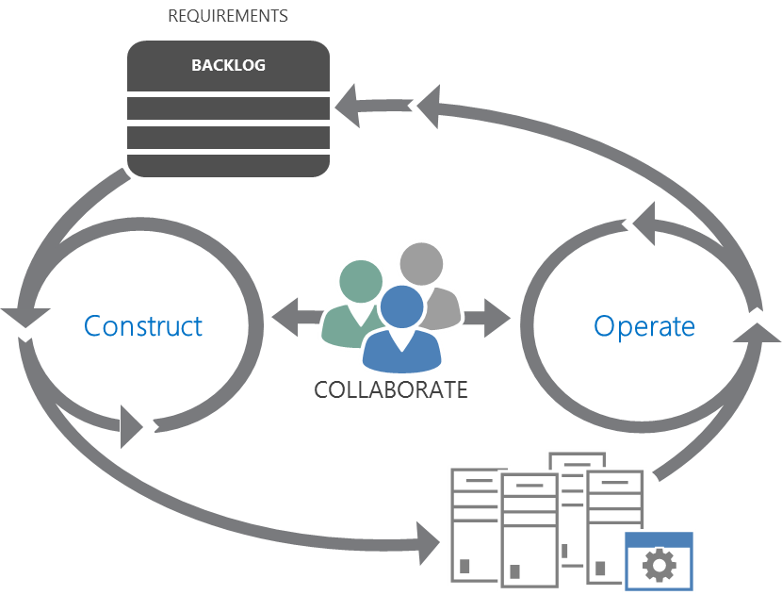
Lifecycle Overview
Plan
Monitor + Learn
Develop + Test
Release
Notes:
The modern ALM process is a continuous cycle
Plan, Develop, Test, Release, Learn
So, we need a rich toolset that can implement this process

Slide 25











Visual Studio 2013 ALM
Source Repos
Agile Planning
Team Rooms
Test Case Management
Feedback Management
Build and Continuous Integration
Team Foundation Server
Visual Studio Online
Notes:
Visual Studio is the key mechanism for implementing ALM
It sits on TFS, which has a core set of ALM capabilities
Source Control
Planning Tools with various processes (like Scrum) supported out-of-the-box
Team Rooms for collaboration support among developers and testers. Yammer-like messaging and alerts
Test Case development
Feedback management from users
Build and Continuous Integration
For Office 365 development, this is critical because there can be many moving parts such as apps, Azure, client-side, Web API, etc. with different teams focused on different parts
Visual Studio Online
Is a cloud-based implementation of TFS
The value is that you don’t have to manage the operations on site

Slide 26
SharePoint Office 365 ALM
Development Environments with Teams
DEV - Each developer gets O365 development sites in isolated tenant
TEST – isolated tenant for integration testing
Build Processes
Utilize Continuous Integration: automatically build and run tests on check in
Azure supports automatic deployment from TFS
Notes:
Each developer gets their own site to achieve isolation
Test is on a separate tenant to support integration and cross-site collection capabilities
Using Continuous Integration ensures all changes are available following a “check in”
Azure can be configured to allow deployment following a “build”

Slide 27
Continuous Integration SharePoint Hosted App
SharePoint Online
Testing tenant or isolated site collection in production depending on app functionality
Visual Studio online or TFS
Storage of the source code
Automated builds
Coded UI / Build verification Tests
Deployment automation with PowerShell and build definitions
4
1
SharePoint On-Premises
Integration testing environment
Possible isolated site collection in production environment, depending on app functionality
2
3
Notes:
Code is checked in for the cloud or on-premises team foundation system
All automation is performed on the TFS side
Test execution and follow up using TFS tooling
Deployment of the SP hosted app to SharePoint can be automated using PowerShell.

Slide 28
Continuous Integration Provider Hosted App
SharePoint Online
Testing tenant or isolated site collection in production depending on app functionality
Could be also on-premises SharePoint
Visual Studio online or TFS
Storage of the source code
Automated builds
Coded UI / Build verification Tests
Deployment automation with PowerShell and build definitions
4
1
5
Microsoft Azure
Provider hosted code is deployed as automated process to the cloud platform
Could be also on-premises or IAAS with private cloud setup
2
3
Notes:
Code is checked in for the cloud or on-premises team foundation system
All automation is performed in the TFS side
Test execution and follow up using TFS tooling
Deployment of the app file to the SharePoint, which could be on-premises or cloud. Notice that since the app file part does not change that often, you will only need to trust the app when there are changes either in the app web or in the required oAuth permissions. Typically you don’t need to redeploy the app file to the SharePoint, which makes the process easier
Deployment of the actual provider hosted app to the provider hosted platform as PAAS, IAAS or on-premises setup. Since majority of the changes are applied on the provider hosted code, this is the part which you’d be deploying as part of the automated builds. App file only when needed.

Slide 29
SharePoint Office 365 Testing Considerations
Tenants can be on different versions
APIs between versions will be subject to roll out schedules
Testing environment should be in the same tenant as “production”
App project and Web project are dependent and should be tested together
Notes:
Remember that the app web and remote web are dependent and should be tested together since tenants can be on different versions

Slide 30
Testing process in high level
SharePoint Online
Testing tenant or isolated site collection in production depending on app functionality
Could be also on-premises SharePoint
Execute Tests
<<deploy app>>
C#
3
<<deploy app>>
1
2
Microsoft Azure
Provider hosted code is deployed as automated process to the cloud platform
Could be also on-premises or IAAS with private cloud setup
4

Slide 31
Testing with multiple environments
Integration testing
Isolated separate tenant or site collection depending on the app specifics
For frequent automated testing
Visual Studio online or TFS
Storage of the source code
Automated builds
Coded UI / Build verification Tests
Deployment automation with PowerShell and build definitions
2
<<deploy app>>
3
Build definition
User acceptance / Quality assurance
Isolated separate tenant or site collection depending on the app specifics
For user acceptance before production usage
1
<<deploy app>>
Release manager
4
5

Slide 32

Questions?

Slide 33


© 2014 Microsoft Corporation. All rights reserved. Microsoft, Windows, and other product names are or may be registered trademarks and/or trademarks in the U.S. and/or other countries.
The information herein is for informational purposes only and represents the current view of Microsoft Corporation as of the date of this presentation. Because Microsoft must respond to changing market conditions, it should not be interpreted to be a commitment on the part of Microsoft, and Microsoft cannot guarantee the accuracy of any information provided after the date of this presentation. MICROSOFT MAKES NO WARRANTIES, EXPRESS, IMPLIED OR STATUTORY, AS TO THE INFORMATION IN THIS PRESENTATION.

